Slide 1
Cyclistic Bike-Share Analysis
How do annual members and casual riders use Cyclistic bikes differently?

Slide 2
Key findings
Members rides
Casual riders
Both riders Pattern
Members ride more frequently and primarily on weekdays, indicating that they use Cyclistic for commuting, while casual riders have significantly lower usage.
Casual riders are more active on weekends, suggesting they use the service for leisure rather than daily transportation.
Members maintain consistent ride patterns throughout the week, while casual riders usage spikes on weekends, highlighting a key behavioral difference that can inform targeted marketing strategies.

Slide 3
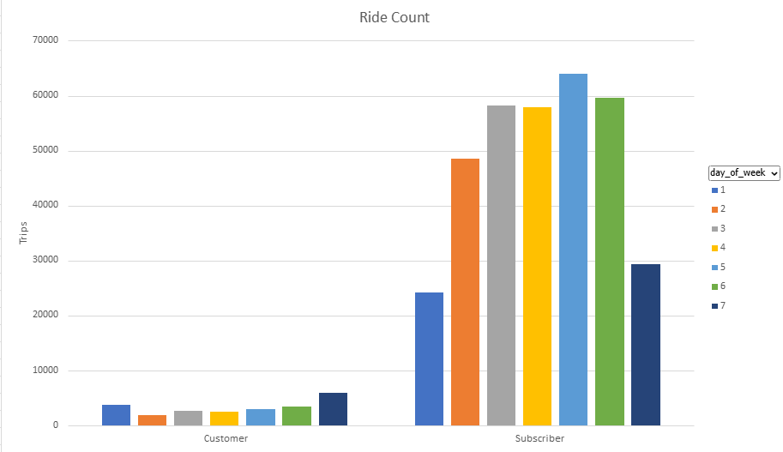
Q1 2019 Analysis
max growth
The data shows that members take significantly more rides than casual riders, especially on weekdays, indicating a strong preference for commuting. In contrast, casual riders exhibit lower but more balanced usage, with a slight increase on weekends, suggesting a focus on leisure trips.

Slide 4
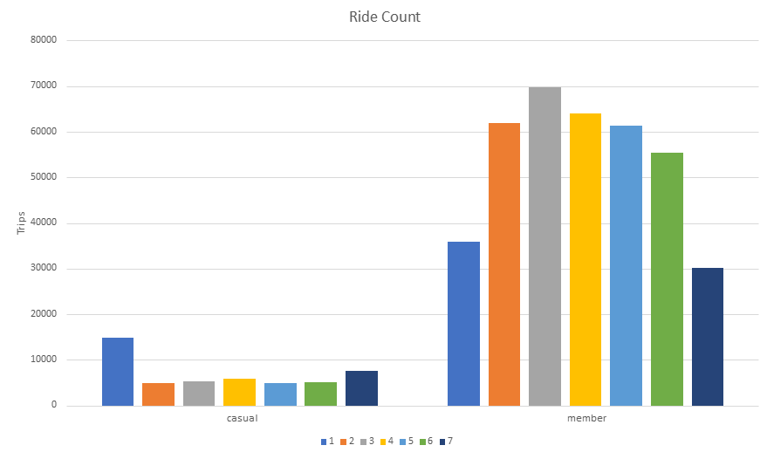
Q1 2020 Analysis
max growth
The trend remains consistent, with members continuing to dominate weekday usage, reinforcing their reliance on Cyclistic for daily transport. Casual rider activity remains concentrated on weekends, highlighting an opportunity to convert them into members through targeted weekend promotions.

Slide 5
Data-Driven Marketing Strategies
Strategie 1
Strategie 2
Strategie 3
Promote Membership Plans for Commuters
Offer exclusive benefits for members, such as faster checkouts or reserved bikes during peak hours.
Convert Weekend Casual Riders with Seasonal Memberships
Since casual riders are active on weekends, introduce a weekend membership plan.
Use Digital Marketing to Retarget Casual Users
Email and in-app notifications promoting the benefits of membership.
Personalized discounts based on casual riders' previous trip history.

Slide 6
Thank you
Abdullahi Mohamed Jeylani

